Slide 1
BTRS System
Abdelrahman Saleh

Slide 2
Agenda
Business Application
Problem definition statement
Proposed solution + functional and nonfunctional requirements
Developpement strategy

Slide 3

Introduction
BTRS (Bus Trips Reserving System): BTRS is a pioneering company dedicated to transforming the way people experience bus travel. At the forefront of innovation, BTRS specializes in providing passengers with an intuitive, secure, and convenient online reservation platform. Our mission is to enhance the travel experience by offering real-time access to a comprehensive list of bus trips, seamless booking services, and robust user accounts. With a commitment to excellence, BTRS is poised to redefine the future of bus travel, ensuring that passengers can explore destinations with ease, comfort, and confidence. Welcome to the next generation of bus travel with BTRS.

Slide 4
Business Application
Business Application
The bus travel industry has been facing many challenges in recent years, such as increasing competition from other modes of transportation and rising fuel costs. To remain competitive, bus companies need to find ways to streamline their operations and improve their customer experience. This is where our web application comes in.
Our web application provides a comprehensive solution for bus companies to manage their operations, including ticketing, scheduling, and fleet management. By using our application, bus companies can save time and money while providing a better experience for their customers. For example, our ticketing system allows passengers to purchase tickets online, reducing the need for manual ticket sales and improving the overall efficiency of the process. Additionally, our scheduling system ensures that buses are running on time and that passengers are able to reach their destinations in a timely manner. Overall, our web application is a necessary tool for bus companies to stay competitive in today's market.

Slide 5
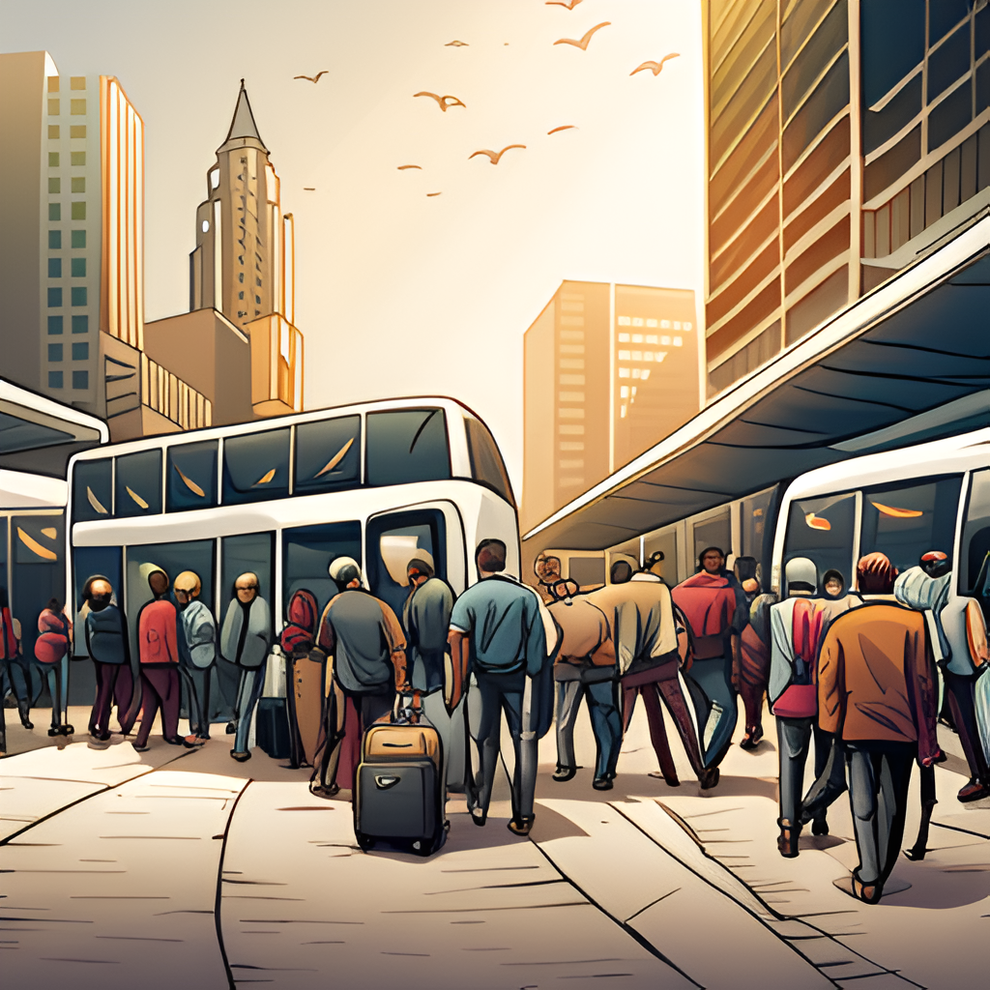
Problem Definition Statement
The main problem that we face is simply that we don’t have a system to manage and provide an easy way for passengers to travel with BTRS ABC as well as , so we want to create a system to provide a simple and easy to use interface that allows the users to use the system with ease and provide the main services that ABC company want to add to their system, such as user-friendly interface, database integration to save all the system’s data, account creation and login, viewing a trip list for users and providing the admin with administration privileges, This is the main solution that we want to adopt to start building this system.

Slide 6
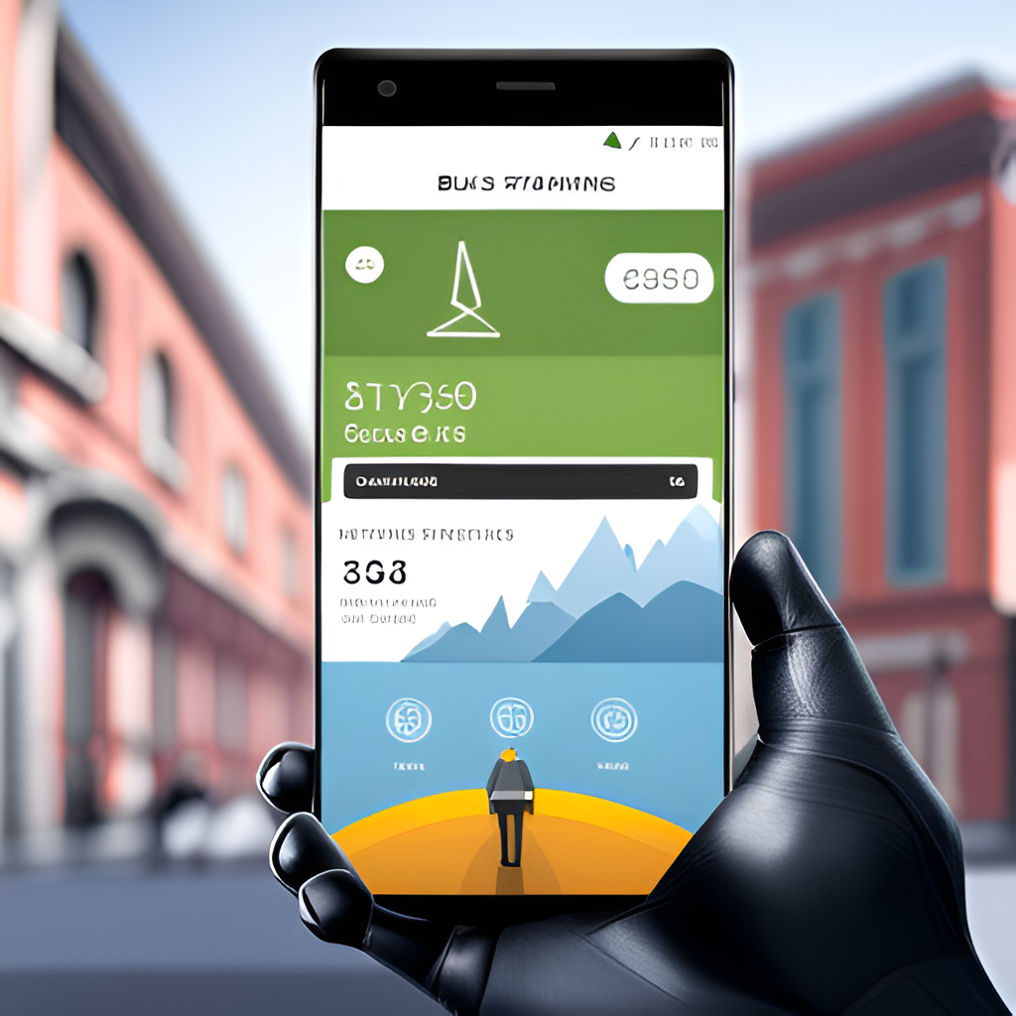
Proposed Solution
The proposed solution is a web application that will streamline the bus travel industry by providing a centralized platform for booking, tracking, and managing bus trips. The application will have two main user interfaces: one for bus operators and another for passengers.
Functional requirements of the application include real-time bus tracking, automated ticketing and payment processing, and customizable trip scheduling. Non-functional requirements include high availability, scalability, and security. By implementing these features, the web application will provide a seamless experience for both bus operators and passengers, reducing wait times and increasing efficiency.

Slide 7
Functional and Non-Functional Requirements for BTRS Scenario
Functional Requirements
Non-Functional Requirements
Account creation: The passenger must be able to create an account on the system.
Data storage: The system must be able to save all passenger information in the database as well as admins information, the details of each trip on the system.
Viewing all available Bus trips: The admin and passenger must be able to view all trips with their details such as start date and time and end date and time...etc.
The Passenger must be able to book one or more trips.
The admin must have proper administrator features such as editing, adding, deleting trip announcements.
The admin must be able to login on the system using his username and password.
The system should provide validation feature to secure admin/passenger Logins and access to the system.
The system should have a user-friendly interface that help the user to navigate the system with ease.
The system should provide quick services such as searching a trip, booking a trip and be able to handle large number of users trying to book at the same time.
The system should be secure and have encryption integrated in the system including database encryption.
The system should have two-step authentication process to provide more security to the system.
The system should be always available and functional to grant passengers access at any time.
The system should be designed to handle increasing number of users and trips without significant performance decrease.
The system should support different languages.

Slide 8

Development Strategy
To develop the BTRS system for ABC Bus Travels, we'll start by understanding their needs and making a detailed plan with clear timelines. Utilizing industry-standard tools such as Visual Studio for development and Visual Paradigm for system design, we'll build the system step by step. Our focus will be on creating a user-friendly design and ensuring data security. Extensive testing, following Agile methodologies, will be crucial to make sure everything works smoothly. Once it's ready, we'll launch it online and provide user support, using tools like SQL Server Management Studio (SSMS) to manage the database efficiently. Continuous monitoring and improvements, guided by Agile principles, will be part of our strategy to keep the system efficient and effective.

Slide 9
Thank you
Application Development

